Slide 1
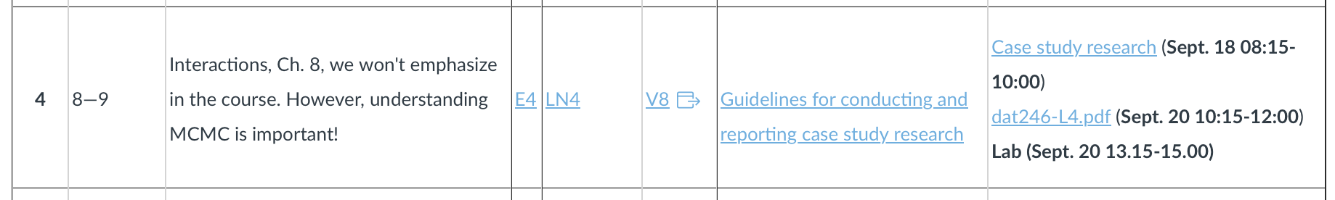

Slide 2
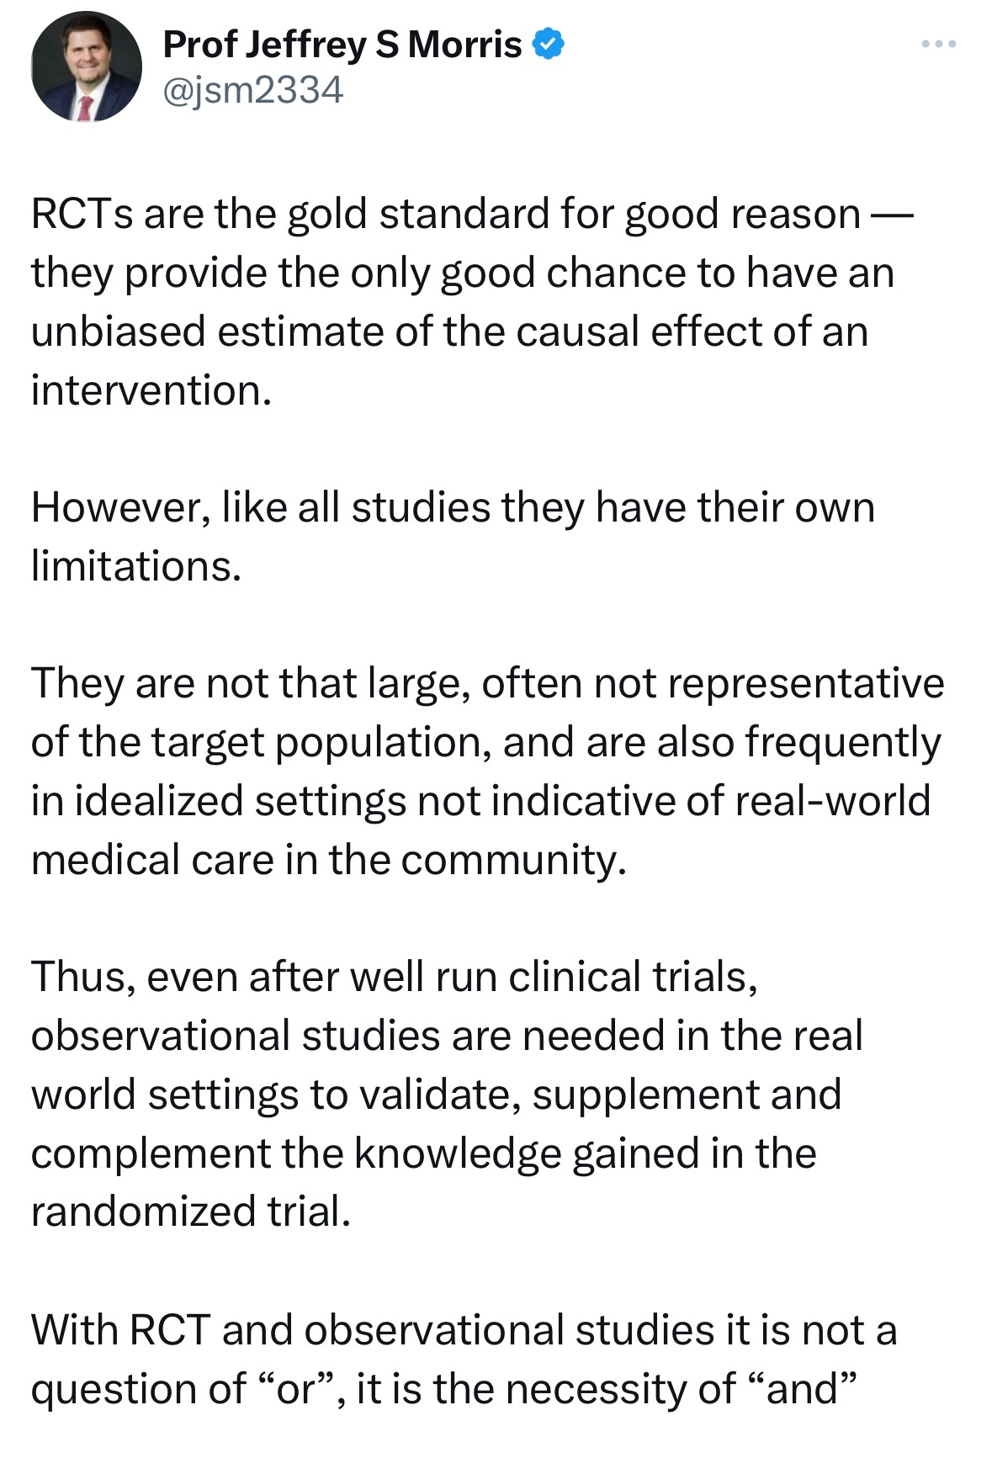

Slide 3
Case Study Research
Richard Torkar
Slides partly contributed by Dr. Erik Stam

Slide 4
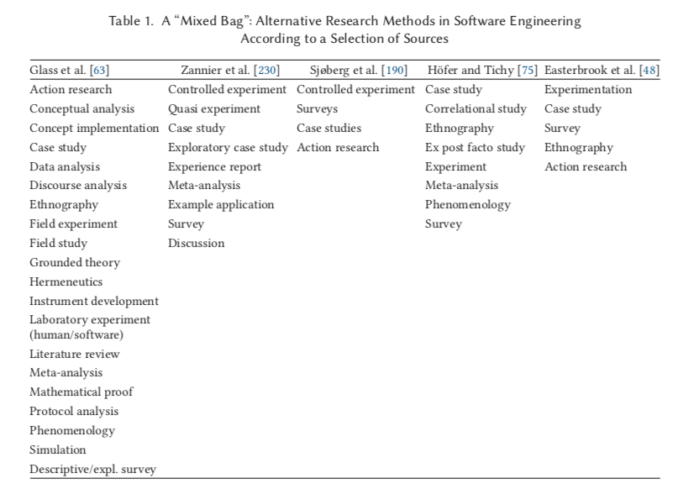
SE research
Multitude of research methods
Wide variety of scope and granularity of the different methods

Slide 5
SE research
Knowledge seeking research
Generate/evaluate/validate scientific claims
Outcomes:
Findings, insights, theoretical/conceptual frameworks, hypotheses
Solution seeking research
Develop new or improve existing solutions
Overcome challenges and bottlenecks
Outcomes:
Artifacts: algorithms, tools, notations, models etc..

Slide 6
SE research
SE research is concerned with the same three components
Actors:
Software professionals
Software systems
Users
Behavior:
Coordination and productivity of developers
System performance and quality
Context:
Industrial setting
Laboratory
Classroom

Slide 7
SE research
”there is no way – in principle – to maximize all the three (conflicting) desiderata of the research strategy domain”
It is impossible to achieve generalizability of the actors, with precise measurement of their behavior in a realistic context
Evaluation of a study:
How well it achieves its potentials?
Not based on criteria that it will never fulfill

Slide 8
Research strategy
Research strategy is a category of research methods that can be categorized by two dimensions
Level of obtrusiveness
To what extent the researcher intrudes the research setting
Observe or manipulate variables?
Context vs Behavior
The extent which findings are generalizable to other settings
Is this study valid for other Actors, Behavior measurements, Contexts?
Not all studies have the goal of being generalizable

Slide 9
Types of research strategy according to ABC paper
Field Studies
Field Experiments
Experimental Simulations
Laboratory experiments
Judgment Studies
Sample Studies
Formal Theory
Computer Simulations

Slide 10
Choice of research strategy
How to select a research strategy?
Depends on:
Goal of the research
Level of obtrusiveness
Desired degree of generalizability of the findings
Generalizability over Actors
Realism of Context
Precision of the measurement of actors’ Behavior

Slide 11
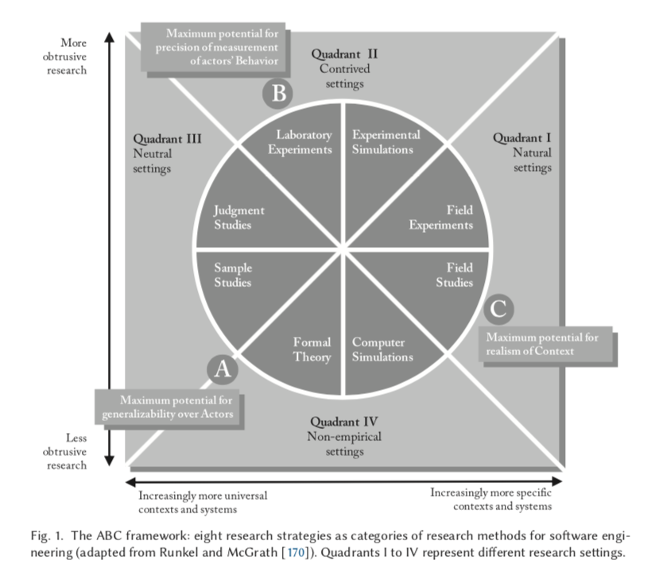

Slide 12
Nobel prize 2019 & 2021

Slide 13
Case studies in se research
Notes:
Case Study: Definition A case study exhibits five essential aspects:
Empirical enquiry 实证调查 or investigation: A case study is an empirical research method.
Contemporary phenomenon 当代现象: A phenomenon “occurring at present, i.e. not primarily using purely historical information”.
Within its real-life context: More specific context of systems.
Using multiple sources: Results from case studies should be based on more than one data source.
Boundary between phenomenon and context is unclear: Unclear border that warrants studying the phenomenon within its real-life context.

Slide 14
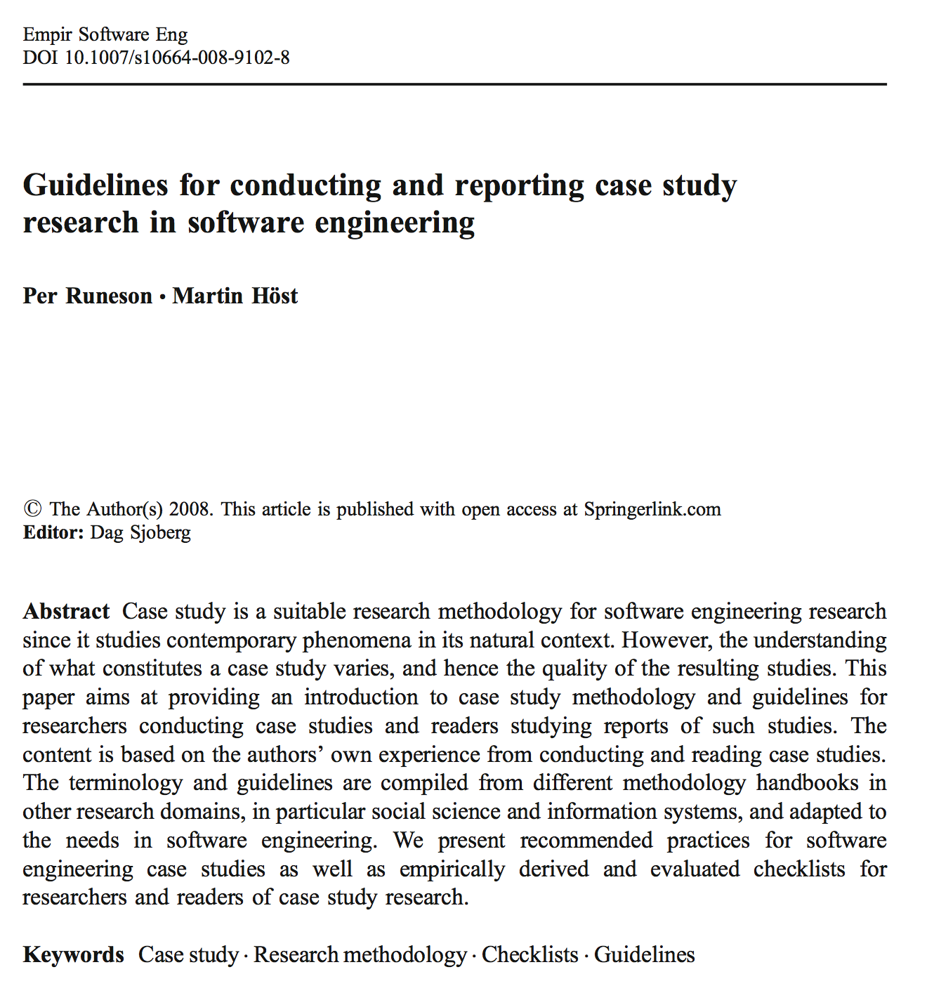
Time to read…

Slide 15
Key points
Definitions from software engineering perspective
Methodologies related to CS research
Survey
Experiment (controlled)
Action research
Design science research
From an SE perspective:
Exploratory—finding out what is happening, seeking new insights and generating ideas and hypotheses for new research.
Descriptive—portraying a situation or phenomenon.
Explanatory—seeking an explanation of a situation or a problem, mostly but not necessary in the form of a causal relationship.
Improving—trying to improve a certain aspect of the studied phenomenon.
Notes:
Purpose
In software engineering, we distinguish four types of research:
Exploratory: finding out what is happening, seeking new insights and generating ideas and hypotheses for new research.
Descriptive: portraying a situation or phenomenon.
Explanatory: seeking an explanation of a situation or a problem, mostly but not necessarily in the form of a causal relationship
Improving: trying to improve a certain aspect of the studied phenomenon.
Note on improving case studies:
The software engineering research community is divided on whether research with an improving purpose can still be considered case studies or rather action research.
Runeson: Case studies in the SE discipline often take an improvement approach, similar to action research. – realistic
Wohlin: In case study research, researchers work with participants in the study, while in action research, researchers are involved in the study. – idealistic
Solution-seeking study

Slide 16
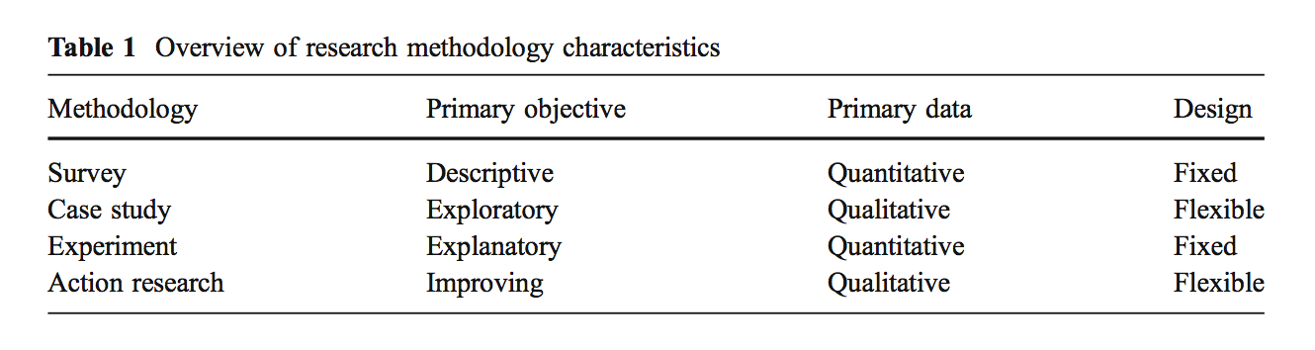
RM characteristics
Notes:
Problem-seeking and

Slide 17
5 major steps
Case study design: objectives are defined and the case study is planned.
Preparation for data collection: data sources, procedures and protocols for data collection are defined.
Collecting evidence: execution with data collection on the studied case and document the process
Analysis: derive insights from the collected data
Reporting: summarize and disseminate the findings
Notes:
Definition: Case
The case may be anything that can be considered a “contemporary phenomenon in its real-life context”. In SE, this may be:
A software development project
An individual, a group of people, an organisation, a role in the organisation.
A process, a product, a policy, or
An event, a technology
Motivation
As a rule of thumb, you select a case/field study strategy when
There are more variables than cases (other than in survey research, where there are more cases than variables), and
The relevant mechanisms are not entirely clear yet.
In SE research, we see three common use cases:
Motivation of research (i.e. to falsify theories)
Inspiration for new ideas (i.e. theory building)
Illustration (i.e. concrete examples of theoretical constructs and to show how causal relationships work)

Slide 18
Design
Objective—what to achieve?
The case—what is studied?
Theory—frame of reference
Research questions—what to know?
Methods—how to collect data?
Selection strategy—where to seek data?
Notes:
Sampling:
How many cases do you need in your case study?
Siggelkow N: If you want to write a case study that derives its excitement and justification through little more than a description of a particular phenomenon, make sure you have a talking pig. If not, a purely descriptive study will be a hard sell.
Aim for either:
One exceptional case, or
Multiple, mutually supporting cases

Slide 19
Case study protocol
The case study protocol is a container for the design decisions on the case study as well as field procedures for its carrying through (execution).
It serves as a guide when conducting the data collection, and in that way prevents the researcher from missing to collect data that were planned to be collected.
The processes of formulating the protocol makes the research concrete in the planning phase, which may help the researcher to decide what data sources to use and what questions to ask.
Other researchers and relevant people may review it in order to give feedback on the plans
It can serve as a log or diary where all conducted data collection and analysis is recorded together with change decisions based on the flexible nature of the research

Slide 20
Data collection
First degree: Direct methods means that the researcher is in direct contact with the subjects and collect data in real time, e.g., interviews, focus groups
Second degree: Indirect methods where the researcher directly collects raw data without actually interacting with the subjects during the data collection (e.g., video recording, GitHub data collection)
Third degree: Independent analysis of work artifacts where already available and sometimes compiled data is used.
Notes:
Important to the validity of the data
Third degree data is artifacts, can be code and et

Slide 21

Data types
Interviews
Observations
Archival data*
Metrics * Very popular approach nowadays…
Notes:
Data Sources:
Several sources of data are eligible in case study research:
Interviews
Observations
Archival data
Metrics

Slide 22
Analysis and validity
Qualitative
Quantitative
Construct validity – Are we measuring what we want to measure?
Internal validity – Casual relations interfering?
External validity – Generalizability?
Reliability – Same results from another researcher?
See checklists in the Runeson & Höst paper!

Slide 23
Outline
What is a case?
Why case study research?
Designing case studies
Example 1:
Example 2:
Summary

Slide 24
What is a case?
A person: ….
A site: an organization – a country
An artefact: technology, product
Units of analysis in case studies:
Events, activities

Slide 25
A case study is an empirical enquiry that:
Investigates a contemporary phenomenon within its real-life context; when
the boundaries between phenomenon and context are not clearly evident; and
multiple sources of evidence are used (Yin 2003:13-14).

Slide 26
Types of…
Illustrative case studies
Exploratory case studies
Cumulative case studies
Critical instance case studies
Notes:
Illustrative - These are primarily descriptive studies. They typically utilize one or two instances of an event to show the existing situation. Illustrative case studies serve primarily to make the unfamiliar familiar and to give readers a common language about the topic in question.
Exploratory - These are condensed case studies performed before implementing a large scale investigation. Their basic function is to help identify questions and select types of measurement prior to the main investigation. The primary pitfall of this type of study is that initial findings may seem convincing enough to be released prematurely as conclusions.
Cumulative - These serve to aggregate information from several sites collected at different times. The idea behind these studies is that the collection of past studies will allow for greater generalization without additional cost or time being expended on new, possibly repetitive studies.
Critical instance - These examine one or more sites either for the purpose of examining a situation of unique interest with little to no interest in generalization, or to call into question a highly generalized or universal assertion. This method is useful for answering cause and effect questions.

Slide 27
Outline
What is a case?
Why case study research?
Designing case studies
Example 1:
Example 2:
Summary

Slide 28
Why case study research?
Rule of thumb: more variables than cases (survey research: more cases than variables)
Relevant mechanisms, variables are not yet clear

Slide 29
Why case study research?
Three important uses:
Motivation of research (falsify theories)
Inspiration for new ideas (theory building)
Illustration: concrete examples of theoretical constructs, show how the causal relationships work
e.g. “dynamic capabilities”: Cisco (Mayer & Kenney 2004); IDEO (Hargadon & Sutton 1997)

Slide 30
Accusation: ‘Case study research is a “convenience” research strategy’
‘… this study used the case study-method because of the complexity of the phenomenon studied. We did in-depth interviews with key actors in the firm.’
‘Not much is known about X, hence we engage in theory building with case study research’
Quick results:
Too limited search in the literature for similar studies, relevant theories
Too limited efforts to select a proper case/sample

Slide 31
Three types of case study research
Research question
Observation Theory Problem
(Theory)
Theory Observation Observation

Slide 32
Theory building (Eisenhardt 1989)
unchartered waters, research as a voyage of discovery
“grounded theory”: iterations between observations and emerging theory (Strauss & Corbin 1990)
Research question
Observation Theory Problem
(Theory)
Theory Observation Observation

Slide 33
Theory testing (Yin 2003)
Social experiment
internal (causal connections) and
external validity (generalisability: stat analysis)
reliability (inter-subjectivity; protocols)
construct validity (operationalisation of concepts)
Research question
Observation Theory Problem
(Theory)
Theory Observation Observation
Notes:
Internal – minimizing systematic error (bias) (see wikipedia page on bias)
External – generalization
Reliability – protocols should be solid, and reproducing results should be possible
Construct – Do we measure what we claim to be measuring?

Slide 34
Problem solving (Van de Ven 2007)
Practical problem central: engage with stakeholders
Problem -> Theory - > Observation (deductive approach)
Working with Industry & Policy
Research question
Observation Theory Problem
Theory Observation Observation

Slide 35
Misunderstandings
Misunderstanding 1: General, theoretical (context independent) knowledge is more valuable than concrete, practical (context-dependent) knowledge.
Misunderstanding 2: One cannot generalize based on an individual case; therefore, the case study cannot contribute to scientific development.
Misunderstanding 3: The case study is most useful for generating hypotheses; that is, in the first stage of a total research process, whereas other methods are more suitable for hypotheses testing and theory building.
Misunderstanding 4: The case study contains a bias toward verification, that is, a tendency to confirm the researcher’s preconceived notions.
Misunderstanding 5: It is often difficult to summarize and develop general propositions and theories on the basis of specific case studies.
Flyvbjerg (2006: 221)

Slide 36
Outline
What is a case?
Why case study research?
Designing case studies
Example 1:
Example 2:
Summary

Slide 37
Designing case studies
How many cases?
1 (Dyer & Wilkins 1991): The talking pig, i.e. an exceptional case
Multiple (Eisenhardt 1989)
“...if you want to write a case study that derives its excitement and justification through little more than the description of a particular phenomenon, make sure you have a talking pig. If not, a purely descriptive study will be a hard sell.” (Siggelkow)
Notes:
Phineas Gage – Talking Pig

Slide 38

Designing case studies
Sampling:
Statistical generalization (cases are representative for a wider population: sample -> population)
Analytical generalization (adequacy of theoretical inferences): replication logic of sampling (multiple case studies)
Select contrasting cases (independent/dependent variables): counterfactual
Select similar cases: saturation

Slide 39
Accusation: ‘Case study research is unscientific because of limited generalizability’
Notes:
Analytical generalization, not statistical generalization
Much statistical generalizations are still no universal generalizations (research done in the US (biotech), does not necessarily apply to Sweden … (business services) )

Slide 40
Designing case studies
Timeframe:
Retrospective:
+: select on the dependent variable
+: compress time (history)
Longitudinal:
+: no ‘survival’ bias
+: measure the effect of designed interventions
Of course, we also have cross-sectional studies
Notes:
Timeframe
Another factor to decide is the timeframe in respect to the case:
Retrospective study:
+ Full view on phenomenon
+ All (available) data accessible at once
Longitudinal study:
+ No survival bias
+ Influence on the data collection
Gives more data, but needs more effort

Slide 41
Designing case studies
Qualitative, quantitative data:
Triangulation in method
N: survey (>40)
semi-structured interviews (10-40)
unstructured interviews (1-10)
participant observation (1)
Notes:
Data: Sampling advice
How much data do you need? There
-design your case study to include triangulation
N: survey (>40)
Semi-structured interviews (10-40)
Unstructured interviews (1-10)
Participation
Triangulation is important to increase the precision of empirical research. Triangulation means taking different angles towards the studied object and thus providing a broader picture.
Types of triangulation:
Data (source) triangulation: using more than one data source or collecting the same data at different occasions.
Observer triangulation: using more than one observer in the study.
Methodological triangulation: combining different types of data collection methods, e.g. qualitative and quantitative methods.
Theory triangulation: using alternative theories or viewpoints.

Slide 42
Outline
What is a case?
Why case study research?
Designing case studies
Example 1: BSD
Example 2: OSS
Summary

Slide 43
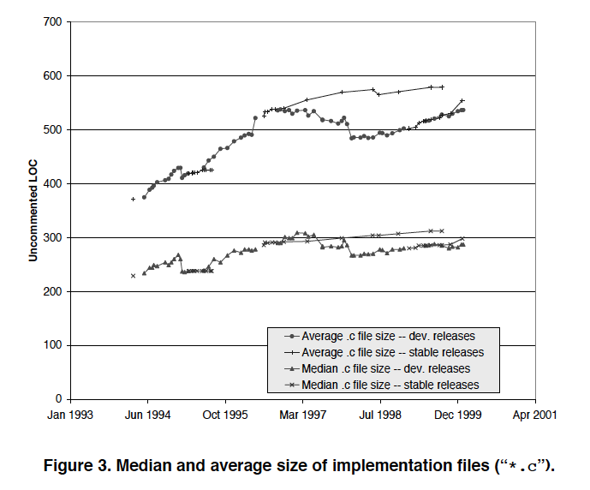
Compare releases between BSD and *nix

Slide 44
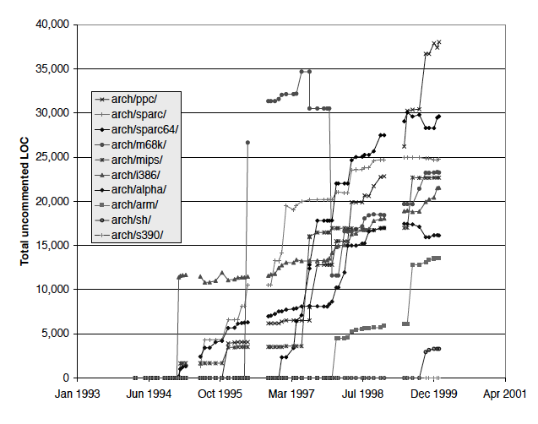
Evolution in open source software
No (complete) theory: theory testing
Initial quantitative survey to explore the field
Theoretical sampling:
Only 2 samples, but a number of variations…
Conclusions
Super-linear growth
Strange (size, model, slow down?)
Nature of subsystems important
Evolutionary patterns
Device drivers a big part (>50%)

Slide 45
Outline
What is a case?
Why case study research?
Designing case studies
Example 1: BSD
Example 2: OSS
Summary

Slide 46
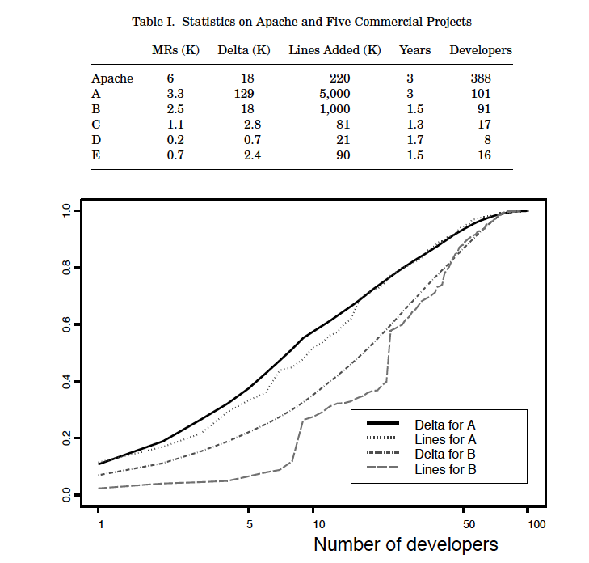
OSS development

Slide 47
OSS development (cont.)
Emphasis on quantitative data (building theory)
How was it done?
the basic structure of the development process,
the number of participants filling each of the major roles,
the distinctiveness of the roles, and the importance of the core developers,
suggestive, but not conclusive, comparisons of defect density and productivity
with commercial projects, and
customer support in OSS. Need for additional qualitative data to uncover the causal mechanisms

Slide 48
Outline
What is a case?
Why case study research?
Designing case studies
Example 1: BSD
Example 2: OSS
Summary

Slide 49
Summary
All research includes cases, but not everything is case study research
Focus on context: uniqueness + analytical generalization
Three types: theory building, theory testing, problem solving
Design choices: no. of cases, timeframe, type of data
Read the bloody paper by Runeson and Höst! ☺
Notes:
Case studies are a valuable, empirical research strategy but far from trivial.
Every research contains cases
Do not aim for complete generalizability, rather focus on the internal validity of your claims.
Make conscious choiices about the study
Replication package

Slide 50
References
Dyer, W.G. and Wilkins, A.L. (1991) Better Stories, Not Better Constructs, to Generate Better Theory: A Rejoinder to Eisenhardt, Academy of Management Review 16(3): 613-619.
Eisenhardt, K.M. (1989) Building Theories from Case Study Research, Academy of Management Review 14(4): 532-550.
Eisenhardt, K.M. (1991) Better Stories and Better Constructs: The Case for Rigor and Comparative Logic, Academy of Management Review 16(3): 620-627.
Mohr, L. (1982) Explaining organizational behaviour. Jossey-Bass: San Francisco.
Stam, E. (2007) Why butterflies don’t leave. Locational behavior of entrepreneurial firms, Economic Geography, 83.1, 27-50.
Strauss, A. and Corbin, J. (1990) Basics of qualitative research: grounded theory procedures and techniques. Sage: London.
Van de Ven, A. (2007) Engaged Scholarship. A guide for organizational and social research. Oxford University Press: Oxford.
Yin, R. (2003) Case Study Research. Design and Methods. 3rd edition. Sage: London.
Runeson, P ad Höst M. (2009) Guidelines for conducting and reporting case study research in software engineering, Empirical Software Engineering 14(2):131-164
Godfrey, M. W. and Tu, Q. (2000) Evolution in open source software: A case study, Int. Conf. on Software Maintenance, 131-142
Mockus, A, Fielding, R. T. and Herbsleb, J. D. (2002) Two case studies of open source software development: Apache and Mozilla, Transactions on Software Engineering and Methodology, 11(3):309-346
Flyvbjerg, B. (2006) Five misunderstandings about case-study research, Qualitative Inquiry, 12(2):219-245

